Slide 1
Predicting Disulfide Connectivity Patterns
Chih-Hao Lu(陸志豪),Yu-Ching Chen(陳玉菁),Chin-Sheng Yu(游景盛),and Jenn-Kang Hwang(黃鎮剛)
Structure, Function, and Bioinformatics 67:262–270 (2007)
Presenter : Chih-Ying Lin
Date : Aug. 04, 2009

Slide 2
Abstract(1/2)
Disulfide bonds play an important role in stabilizing protein structure and regulating protein function. Therefore, the ability to infer disulfide connectivity from protein sequences will be valuable in structural modeling and functional analysis. However, to predict disulfide connectivity directly from sequences presents a challenge to computational biologists due to the nonlocal nature of disulfide bonds, i.e., the close spatial proximity of the cysteine pair that forms the disulfide bond does not necessarily imply the short sequence separation of the cysteine residues. Recently, Chen and Hwang(Proteins 2005;61:507–512) treated this problem as a multiple class classification by defining each distinct disulfide pattern as a class. They used multiple support vector machines based on a variety of sequence features to predict the disulfide patterns. Their results compare favorably with those in the literature for a benchmark dataset sharing less than 30% sequence identity.

Slide 3
Abstract(2/2)
However, since the number of disulfide patterns grows rapidly when the number of disulfide bonds increases, their method performs unsatisfactorily for the cases of large number of disulfide bonds. In this work, we propose a novel method to represent disulfide connectivity in terms of cysteine pairs, instead of disulfide patterns. Since the number of bonding states of the cysteine pairs is independent of that of disulfide bonds, the problem of class explosion is avoided.The bonding states of the cysteine pairs are predicted using the support vector machines together with the genetic algorithm optimization for feature selection. The complete disulfide patterns are then determined from the connectivity matrices that are constructed from the predicted bonding states of the cysteine pairs. Our approach outperforms the current approaches in the literature.

Slide 4
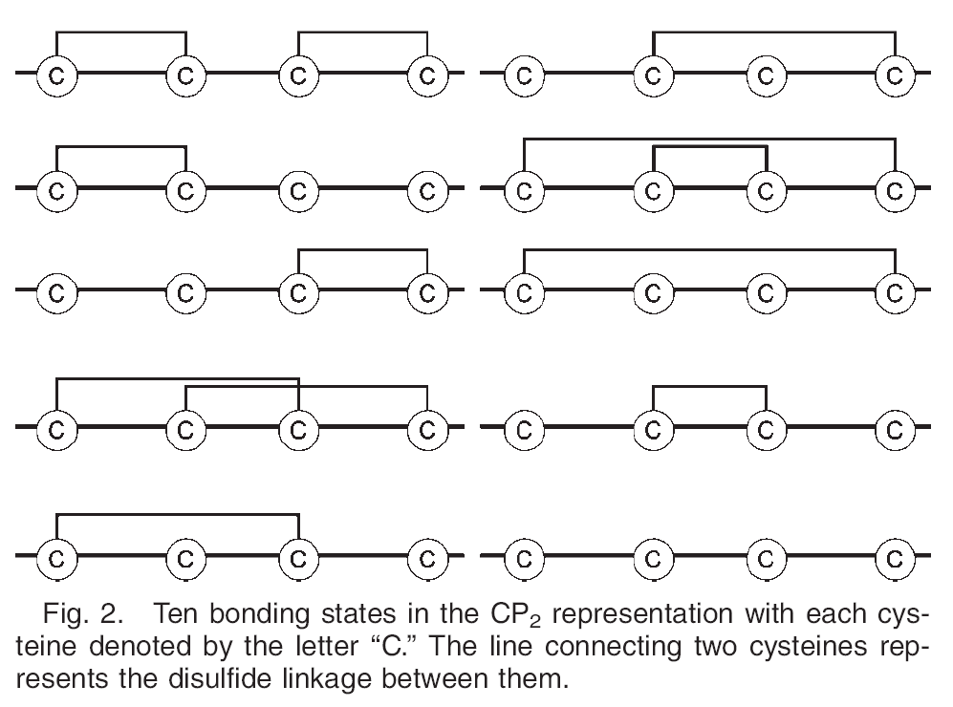
CP₂ representation

Slide 5
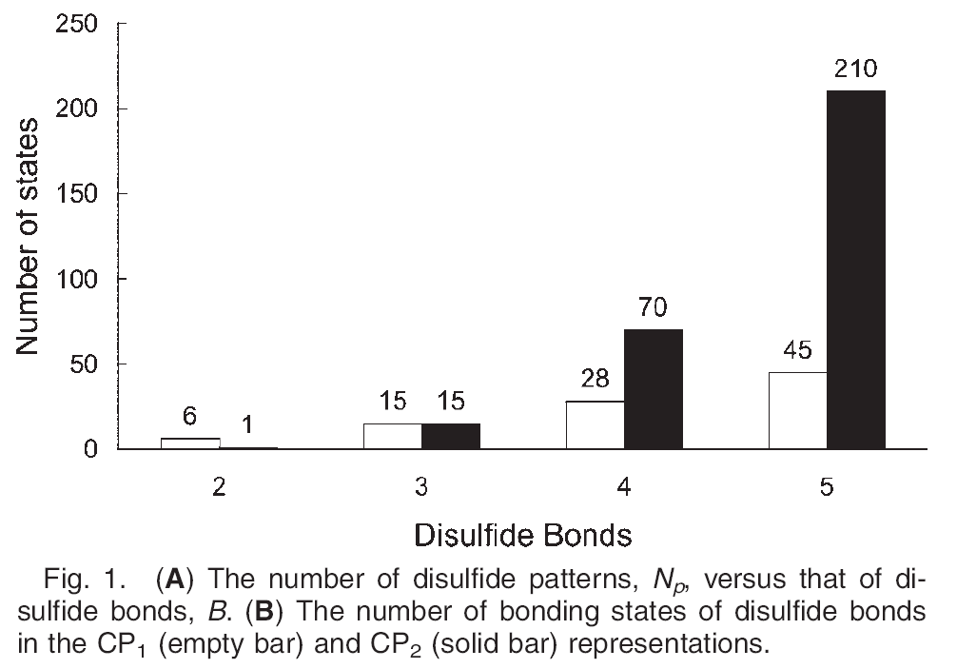
CP₂ representation

Slide 6
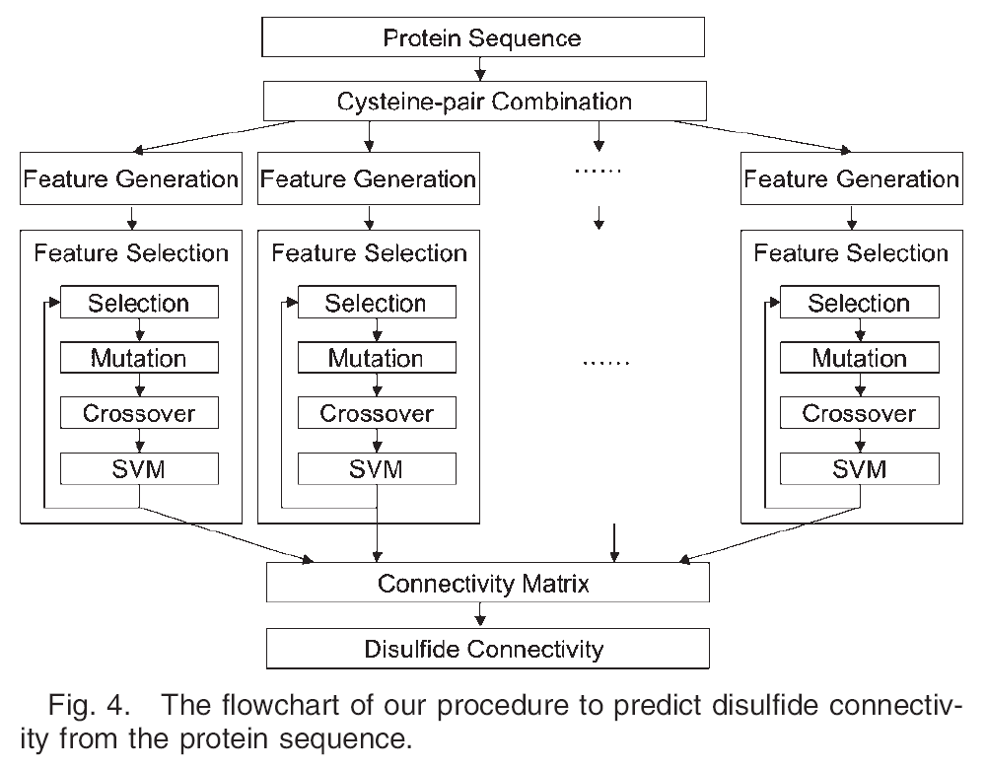
Flowchart

Slide 7
The Feature Vectors
Cysteine separation
Amino acid composition
Cysteine–cysteine coupling

Slide 8
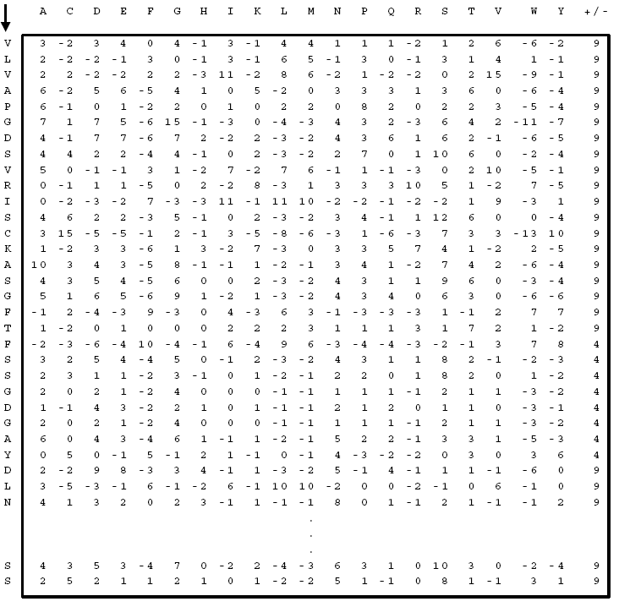
Cysteine–cysteine coupling
10 | 15 | 0 | 0 | 9 | 9 | 0 | 11 | 7 | 0 | 0 | 0 | 0 | 0 | 10 | 31 | 0 | 10 | 0 | 0
Notes:
Let w_{i}=(a_{l-l,}…,a_{i-1,}a_{i},a_{i+1},…a_{i+l}) denote the sequence window of size 2l +1 centered around the bonded cysteine at the ith position, where a_{k} is the kth amino acid. We
define a 20-element vector v_{w} = (v₁^{wi,}v₂^{wi}. . .v₂₀^{wi}) associated with the sequence window w_{i}, where v_{k}^{wi} is the PSSM element of the amino acid type k. If the amino acid of a given type occurs more than once within the window, v_{k}^{wi} is the sum of the associated PSSM elements. The coupling between the ith and jth cysteines is computed by s_{ij}
= c_{i}v_{wj +} c_{j}v_{wj} , where c_{k} is the PSSM element of cysteine type at the kth row. For a given disulfide pattern, we sum up all the possible cysteine pairs to get s=∑_{ij}s_{ij}

Slide 9
Feature Selection
Si = (Fi,Xi,Gi)
Selection operator
Mutation operator
α : Fi => ¬Fi threshold = 0.1
β : random one bit mutation
Crossover operators
One bit crossover threshold = 0.5

Slide 10
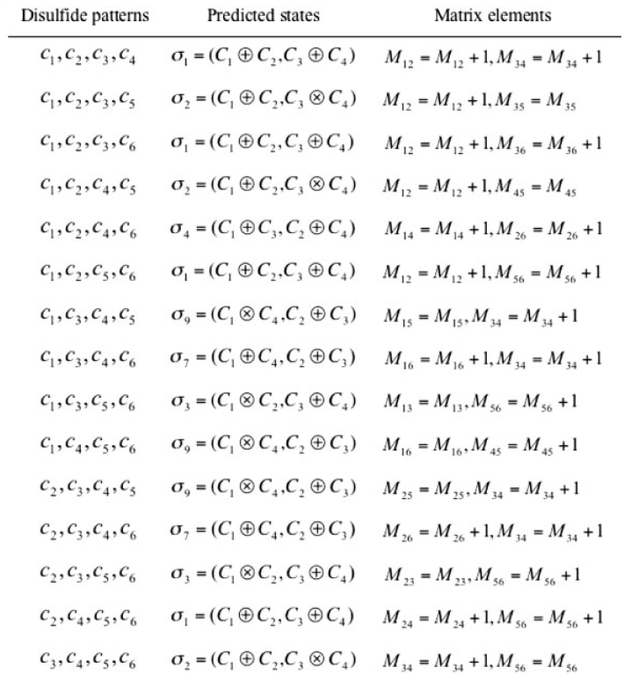
connectivity matrix

Slide 11
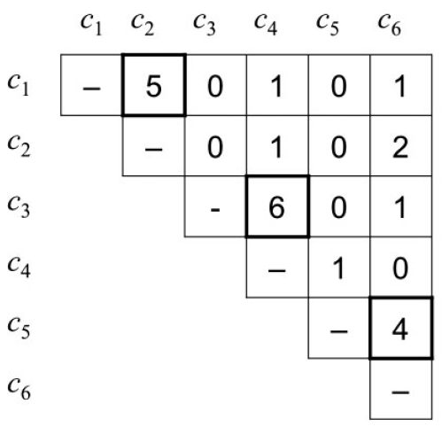
connectivity matrix

Slide 12
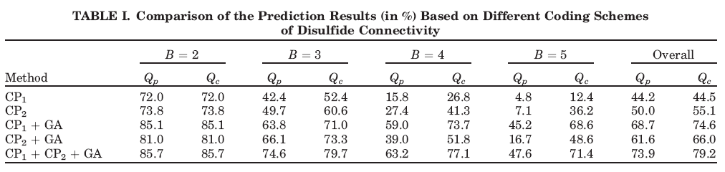
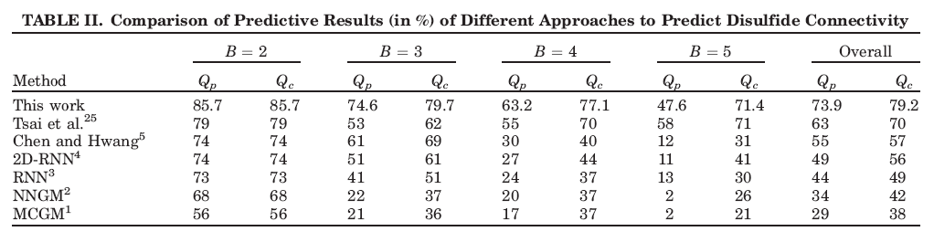
Results
80.8 | 80.8 | 57.5 | 66.2 | 54.5 | 70.7 | 42.2 | 61.8 | 63.5 | 70.1

Slide 13
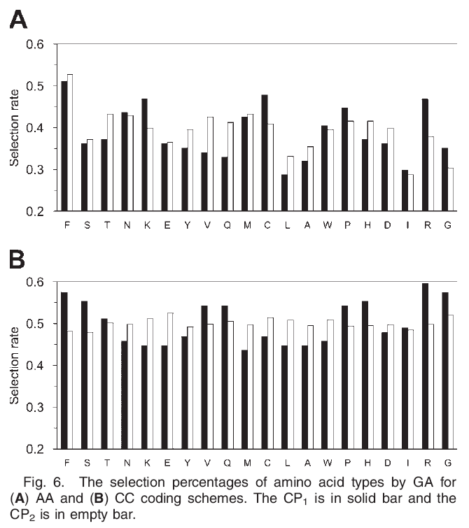
The selection percentages of amino acid types by GA

Slide 14
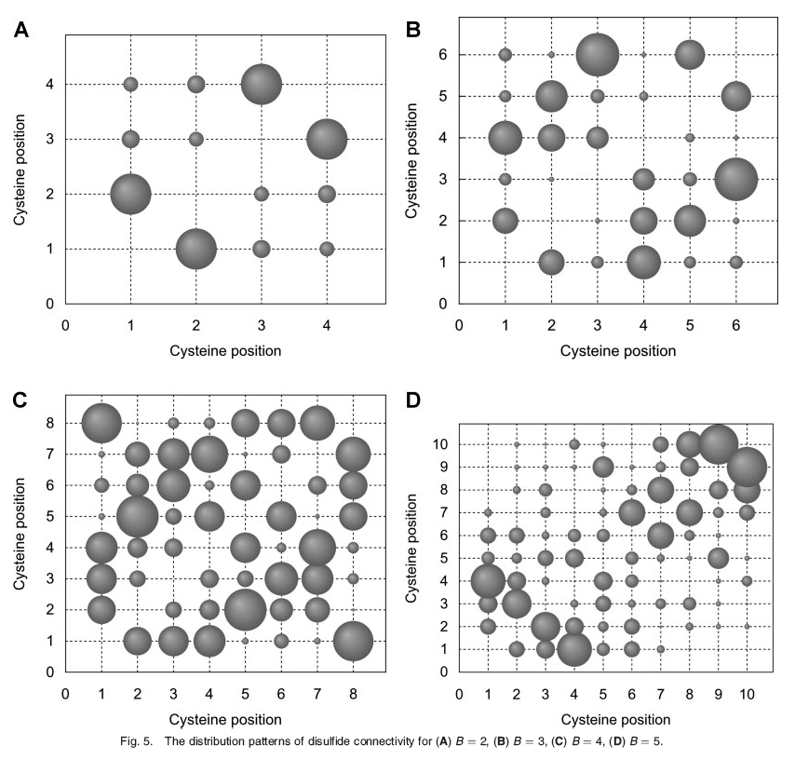
Distribution of Cysteine Pairs Forming Disulfide Bridges

